Slide 1
Optimization for Games

Slide 2
Overview
The Problem
Gradient Descent
Genetic Algorithms
Examples
References

Slide 3
The Problem
Problem: setting parameters
Example 1:
Strategy Game with diferent kind of units
Every unit have diferent attributes (attack, defense, life points)
All the units have to be useful
We need to balance them
Example 2:
Game difficulty level adjustment
Example 3:
Setting parameters of a Machine Learning algorithm

Slide 4
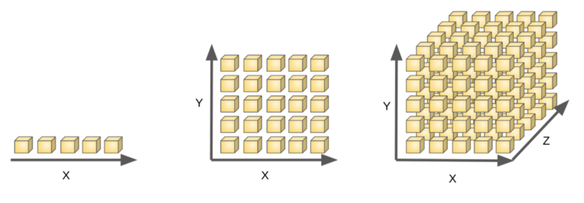

Context
Problem: Strategy Game
10 unit types
3 attributes (attack, defense, life)
20 possible values (1..20)
So the possible combinations will be
testing all combinations is impossible
Solution:
Find a reasonably good solution in a limited time
Optimisation algorithms
The Curse of Dimensionality
source

Slide 5
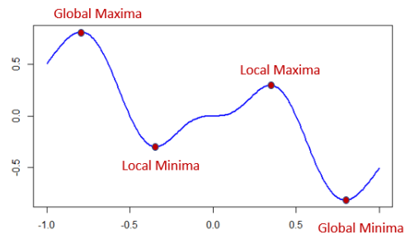
The Problem in Optimization
Objective function: many minima/maxima
Simplest methods get stuck in local minima

Slide 6
Overview
The Problem
Gradient Descent
Genetic Algorithms
Examples
References

Slide 7
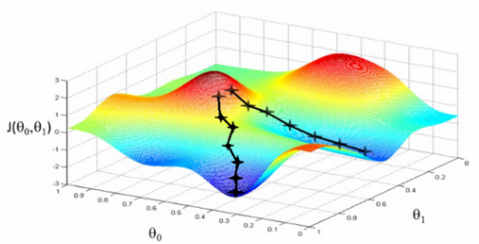
Gradient Descent
source
Methafor: going down a mountain to the lowest point.
Gradient (partial derivatives) gives the direction of steepest descent

Slide 8
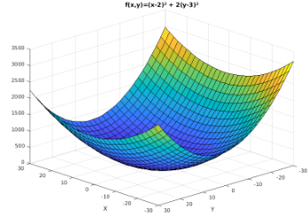

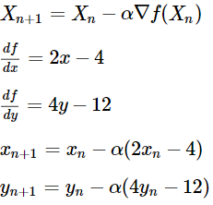
Gradient descent example
Let's the function:
Optimization:
In python:
view / notebook
Source: Lulu's blog

Slide 9
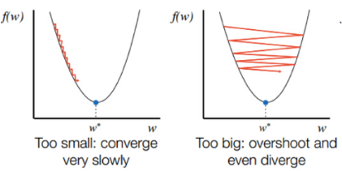
Hyperparameter: Step Size
Step size (η): factor to the gradient (arrow length)
Too small: progress will be sloooooow
Too big: it may jump over minima or go back and forth
Can be adaptive (decrease with iterations)
source

Slide 10
Overview
The Problem
Gradient Descent
Genetic Algorithms
Examples
References

Slide 11

Hyperparameter: Step Size
Given a problem P with a solution space S, the main components are:
Chromosome (solution): collection of genes (parameters)
Population: collection of chromosomes
Fitness function: scores how good is a solution
Selection: selects best chromosomes
Crossover: from 2 random chromosomes & a random point:
requirements:
2×n
2×n parents for each
n
n new chromosomes

Slide 12

Genetic Algorithm II
Mutation: change a value
Probability of mutation (<10%)
Random index
Random number to add or substract
Algorithm:
Random Population
Compute fitness
Selection
Crossover
Mutation
Go to step 2

Slide 13
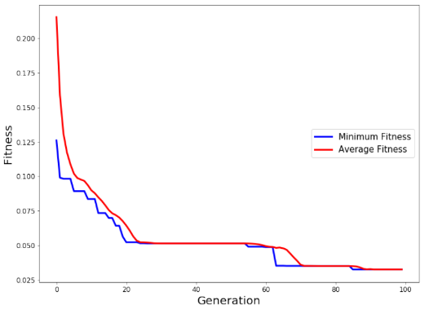
Behavior

Slide 14
Overview
The Problem
Gradient Descent
Genetic Algorithms
Examples
References

Slide 15
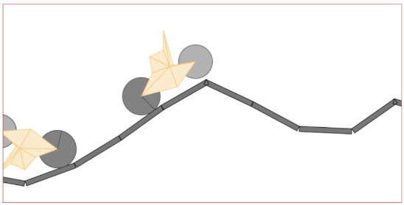
Live Demo!
HTML Genetic Cars in js:
web / github

Slide 16
Frozen Lake in AI Gym
Toy text environment:
SFFF (S: starting point, safe)
FHFH (F: frozen surface, safe)
FFFH (H: hole, fall to your doom)
HFFG (G: goal, where the frisbee is located)
Actions:
LEFT = 0
DOWN = 1
RIGHT = 2
UP = 3
In python: code
Lecture https://becominghuman.ai/genetic-algorithm-for-reinforcement-learning-a38a5612c4dc

Slide 17
Overview
The Problem
Gradient Descent
Genetic Algorithms
Examples
References

Slide 18
References
Ian Millington. AI for Games (3rd edition). CRC Press, 2019.
Rafael Matsunaga. Genetic Cars, github.
Sebastian-Schuchmann. Genetic Algorithm in Unity.
Kip Parker. Building a neural network framework in C#.
Viktor Seč. Karl Sims - Evolving Virtual Creatures With Genetic Algorithms. 1994.
Thomas Geijtenbeek. Flexible Muscle-Based Locomotion for Bipedal Creatures. 2013.

